Slide 1
Tumors of bone
Dr. Goutami Katage Shah
Dept. Of Musculoskeletal Physiotherapy
MGM Institute Of Physiotherapy
Chh. Sambhajinagar

Slide 2
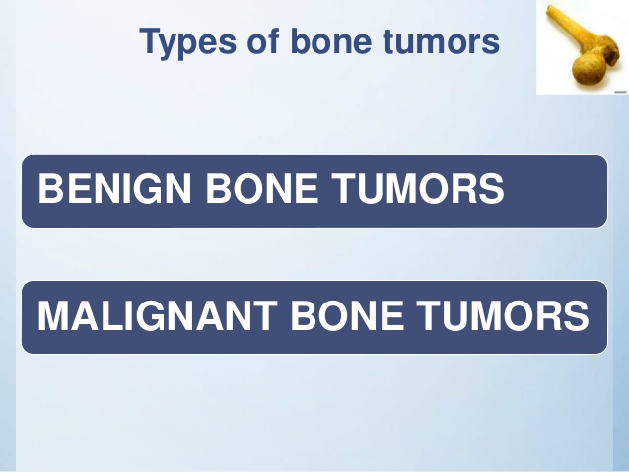

Slide 3
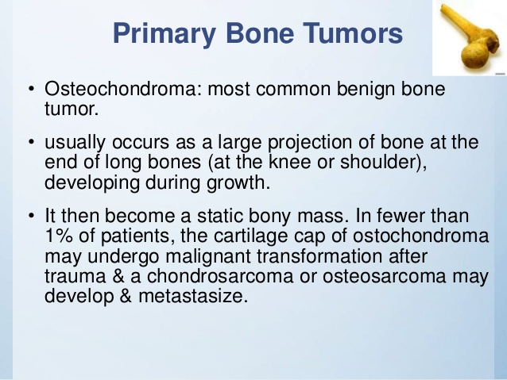

Slide 4
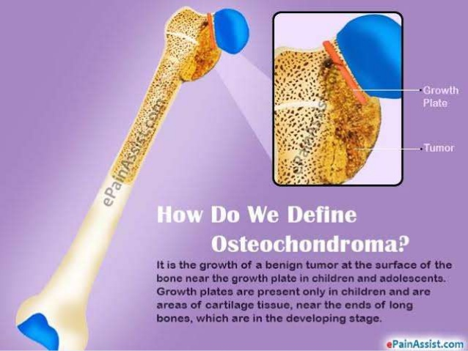

Slide 5
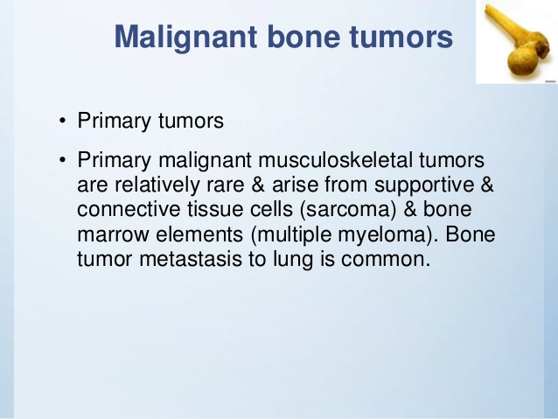

Slide 6
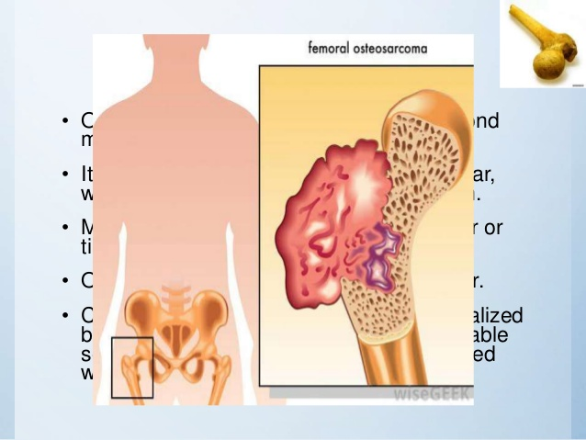

Slide 7
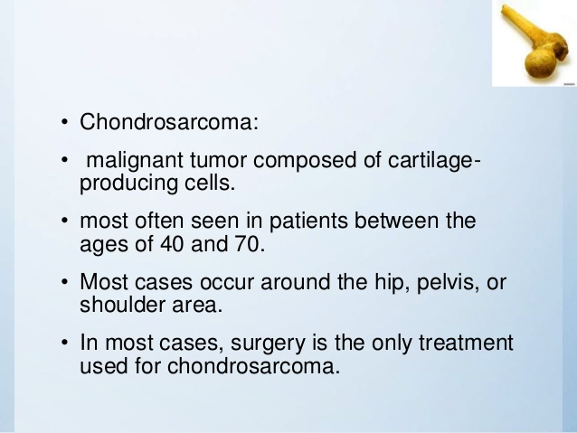

Slide 8
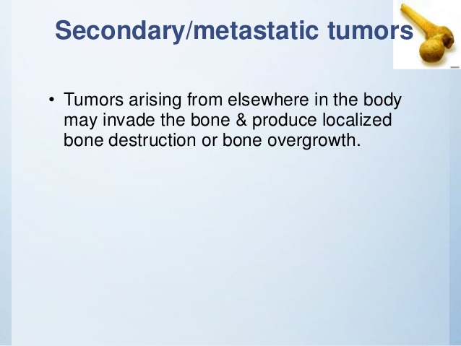

Slide 9
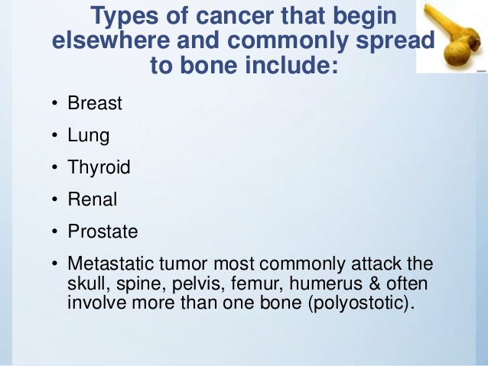

Slide 10
CLINICAL FEATURES
Pain , swelling
Limited mobility
Night sweats
Painless mass or obvious bone growth
Varying degree of disability
Weight loss
Progressive pain
Weakness
Gait abnormality
Parasthetia , paraplegia

Slide 11
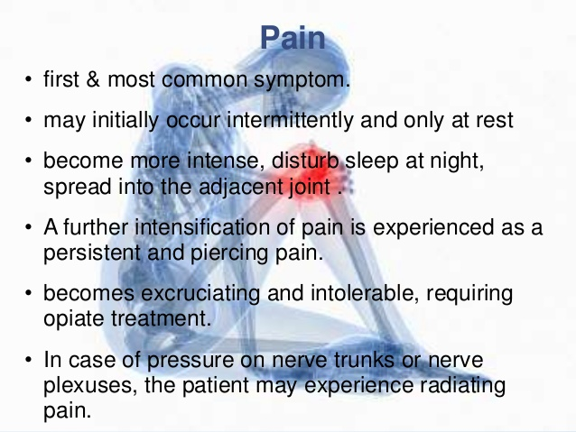

Slide 12
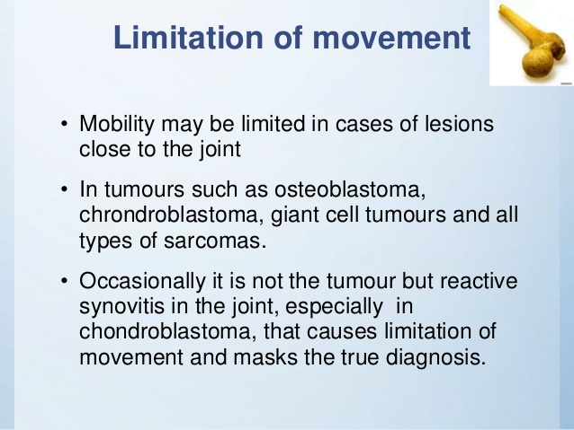

Slide 13
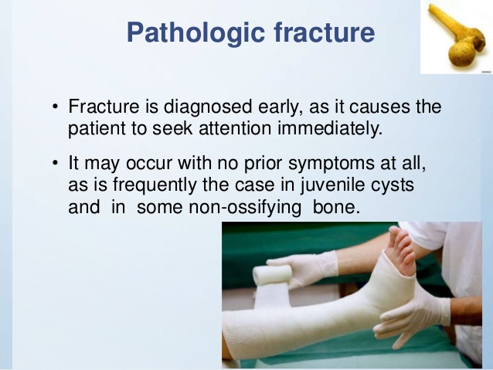

Slide 14
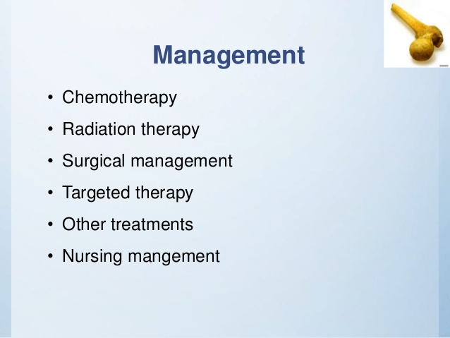

Slide 15
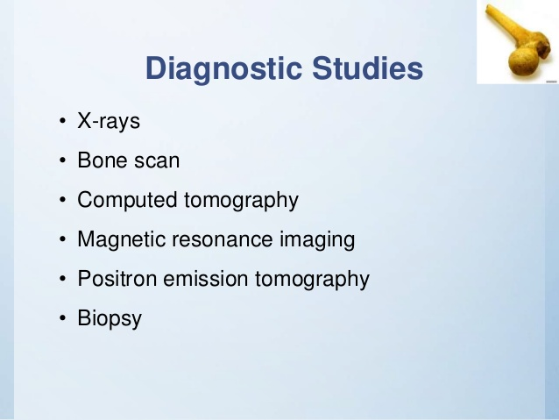

Slide 16
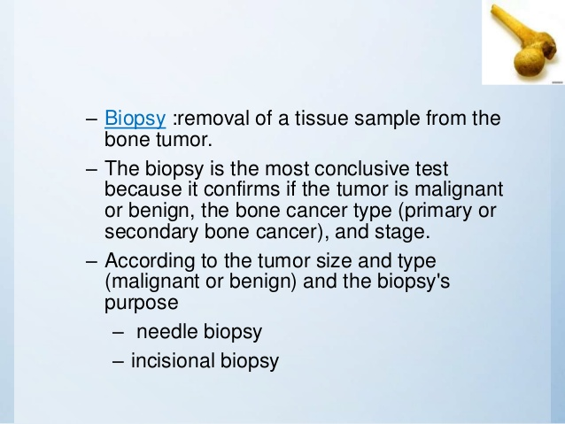

Slide 17
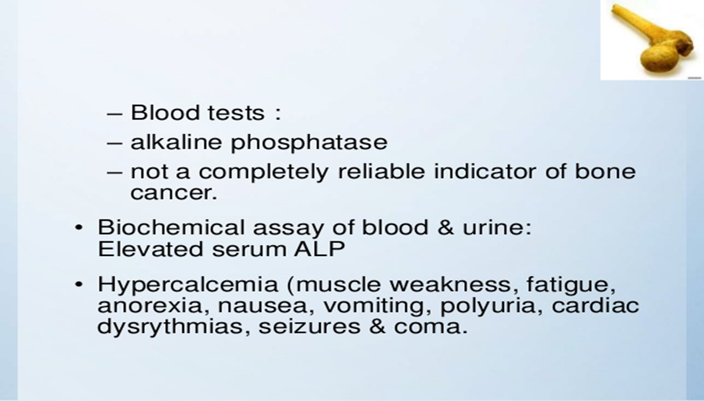

Slide 18
GRADES
Stages-
All stage I - tumors are low grade
Stage I A –Tumor less than or to 8cm
Stage I B- Tumor is larger than 8cm
Stage II- Tumors not spread outside the bone
Stage III- Tumors not spread outside the bone but are more than in 1 place of the same bone
Stage IV- Tumor has spread outside the bone

Slide 19
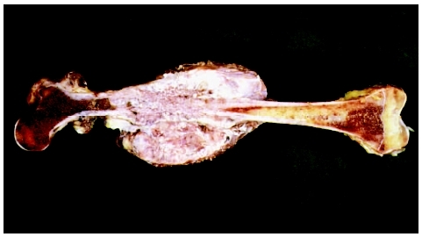
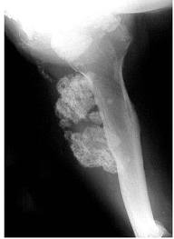
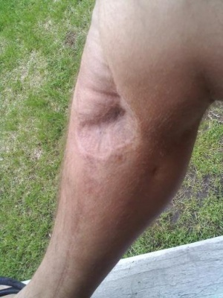

Slide 20
Physical therapy interventions will consist of early postsurgical mobility training, strength and endurance restoration, pain control, and education and training of family members in helping patients with limited mobility.
Physical therapists will help to correct balance and coordination impairments, make recommendations for home modifications that will enhance the patient’s independence, and educate and train the family members to assist and enable the patient to function independently.
In addition, physical therapists will train the patient in stump management and training with the prostheses for those patients who undergo amputation

Slide 21
